Slide 1
WBL Mentor Competence Certification Scheme
Candidates & Examiners Training
November 30th 2020

Slide 2
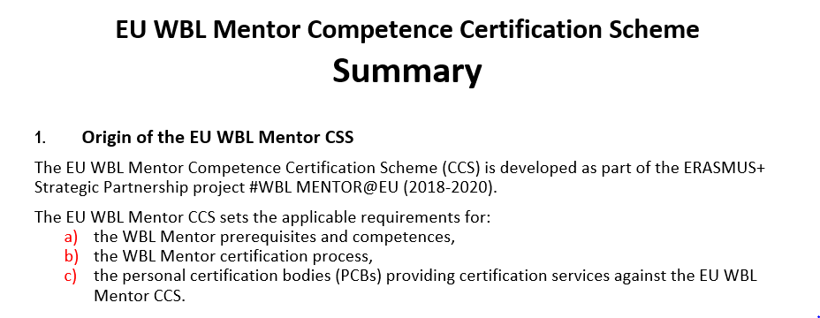
Summary

Slide 3
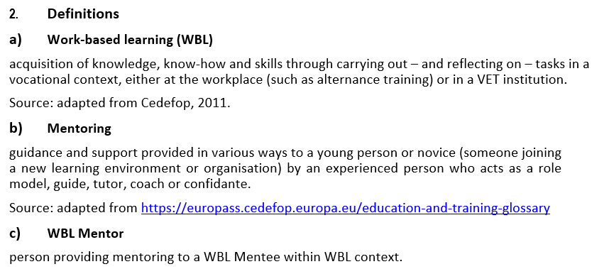
Definitions

Slide 4
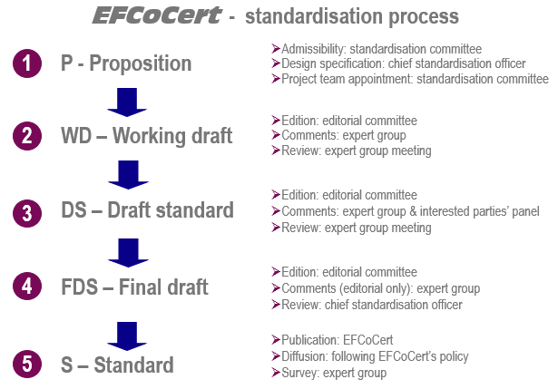
Standardisation Process

Slide 5
Experts’ Committee
Name | First name |  | Organisation | Interested parties
BARTSOKA | Maria | GR | OAED | Authorities
BESKESE | Ahmet | TR | BAU | University
BLANC | Didier | CH | EFCoCert Foundation | Foundation / Certification / Standardisation
ERZURUMLU | Yaman | TR | BAU | University
GOMEZ GUTIERREZ | Fabian | SP | FyG Consultores | Consulting & Research
GOYA | Miguel Angel | SP | Andalucia Emprende | Public Regional Foundation for Entrepreneurs
KALLERGI | Jennie | GR | DIEK Egaleo | VET School
KAROULAS | Gerasimos | GR | IME GSEVEE | Chamber of Commerce
KIRIAKOS | Dimitris | GR | DIEK Egaleo | VET School
LE LANN | Florence | CH | ViaSyst SA | Private SME
LEE | Mark | US/AUS | IBSTPI | Private Standardisation
MERKOS | Stephanos | GR | OAED | Authorities
MINTON | Ann | UK | University of Derby | University
MYSIRI | Elisa | GR | IME GSEVEE | Chamber of Commerce
NIEDZWIEDZ | Joanna | UK | C4FF | Consulting & Research
PERROTTET | Stéphane | CH | EdelCert | Certification Body
RANELLETTI | Andrea | IT | Erifo Project | Center for research and lifelong learning
SINGH | Lakvir | UK | C4FF | Consulting & Research
SIOMADIS | Vassilis | GR | IME GSEVEE | Chamber of Commerce
TAVELLA | Andrea | IT | E.RI.FO | Center for research and lifelong learning
TUNC BOZBURA | F. | TR | BAU | University
TUZCUOGLU | Selcuk | TR | BAU | University
ZIARATI | Reza | UK | C4FF | Consulting & Research

Slide 6
Scheme Experts Committee
Interested to participate?
Please apply!
5.3 Experts group
5.3.1 Experts Group profile
The collective profile of the experts group shall comply to following specifications and competences:
technical, managerial and academical expertise of the sector concerned by the standardisation project;
experience of national or international standardisation work;
representation of all interested parties (see 4.2.3);
control of English and/or development language of the standardisation project;
The chief standardisation officer shall be active in searching to complete the group in case of important gap.
5.3.2 Experts commitments
By accepting his appointment, any expert shall be committed to, in particular:
comply in any point with EFCoCert Standardisation Guidelines;
ensure the necessary availability, as a volunteer;
participate actively, in his personal name and in name of his expertise, to the votes and consultations;
accept that his participation is publicly mentioned.
Documented evidence shall be maintained of the experts’ commitment (see Annex D).

Slide 7
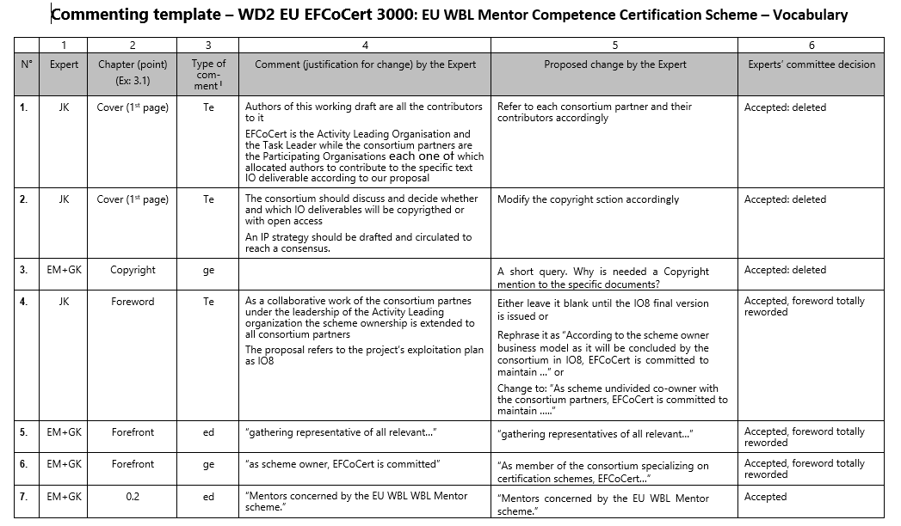
Commenting Template

Slide 8
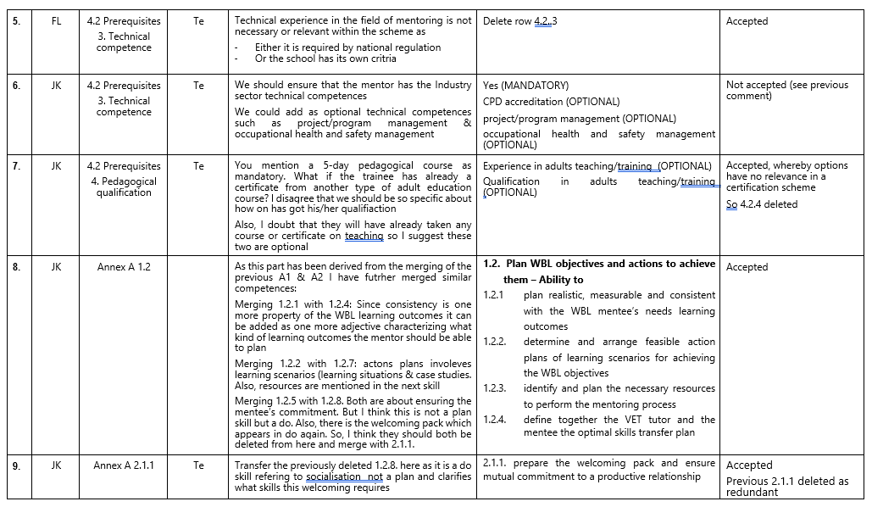
Commenting Template

Slide 9
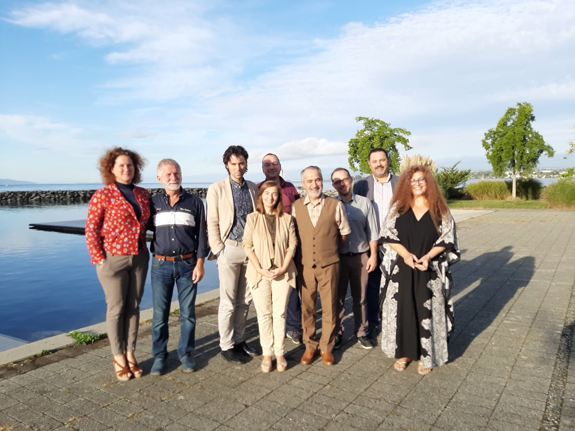
Experts’ Contribution
87 comments on working draft
24 comments on draft standard
44 comments on final draft standard (new Annex C)
130 comments on exam material
… comments raised during the pilot

Slide 10
Competence Certification Scheme
ISO 17024 requirements for competence certification schemes
8. Certification schemes
8.1 There shall be a certification scheme for each category of certification.
8.2 A certification scheme shall contain the following elements:
scope of certification;
job and task description;
required competence;
abilities (when applicable);
prerequisites (when applicable);
code of conduct (when applicable).
NOTE 1 A code of conduct describes the ethical or personal behavior required by the scheme.
NOTE 2 Abilities can include physical capabilities such as vision, hearing and mobility.
8.3 A certification scheme shall include the following certification process requirements:
criteria for initial certification and recertification;
assessment methods for initial certification and recertification;
surveillance methods and criteria (if applicable);
criteria for suspending and withdrawing certification;
criteria for changing the scope or level of certification (if applicable).

Slide 11
Mentor4WBL Certification Scheme
The EU WBL Mentor Competence Certification Scheme consists of the following normative documents:
EU MENTOR4WBL 3000: Fundamentals and vocabulary
EU MENTOR4WBL 3001: Requirements:
Prerequisites
Competence Matrix
Certification levels
Code of conduct
Certification exam
EU MENTOR4WBL 3002: Exam material
EU MENTOR4WBL 3024: Requirements for certification bodies:
Requirements for certification bodies
Requirements for examiners
Certification contract
Certification process & exams
Certificate
Integrity programme

Slide 12
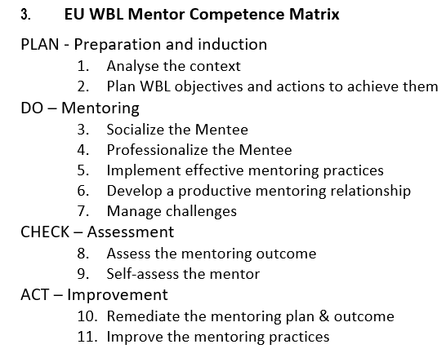
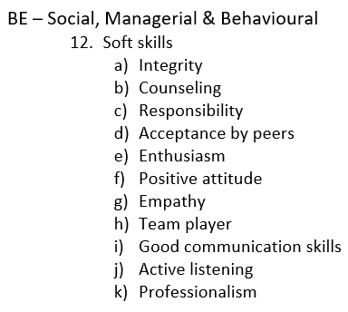
Competence Matrix

Slide 13
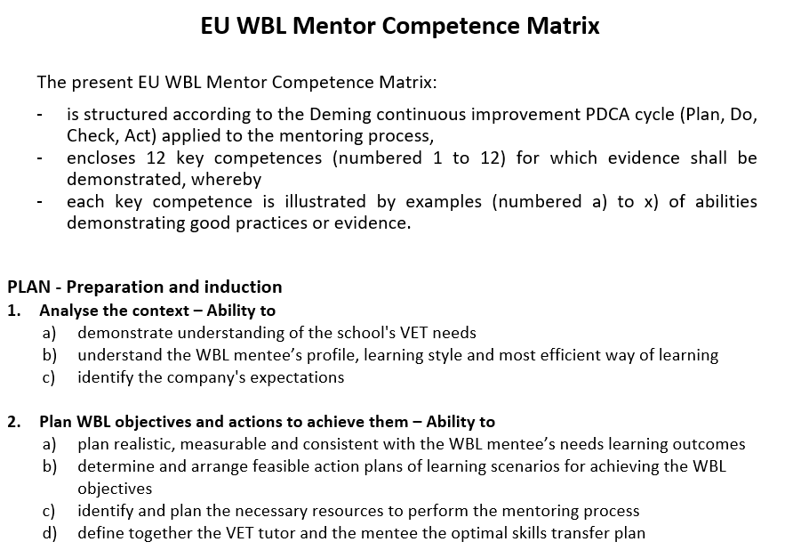
Competence Matrix

Slide 14
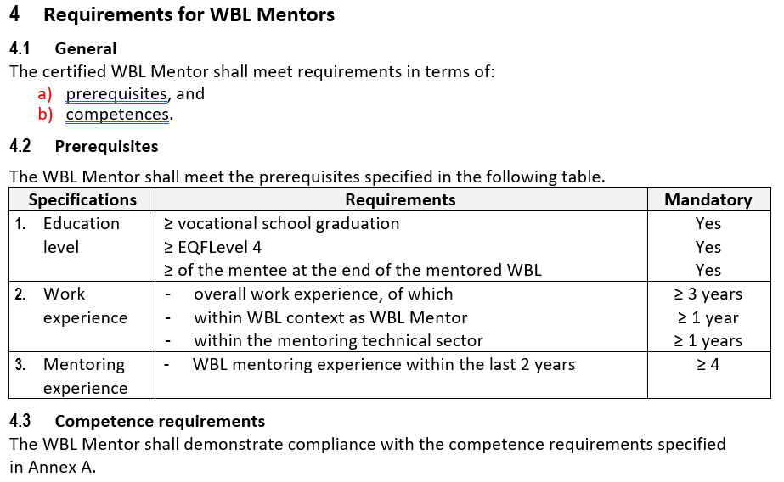
Prerequisites

Slide 15
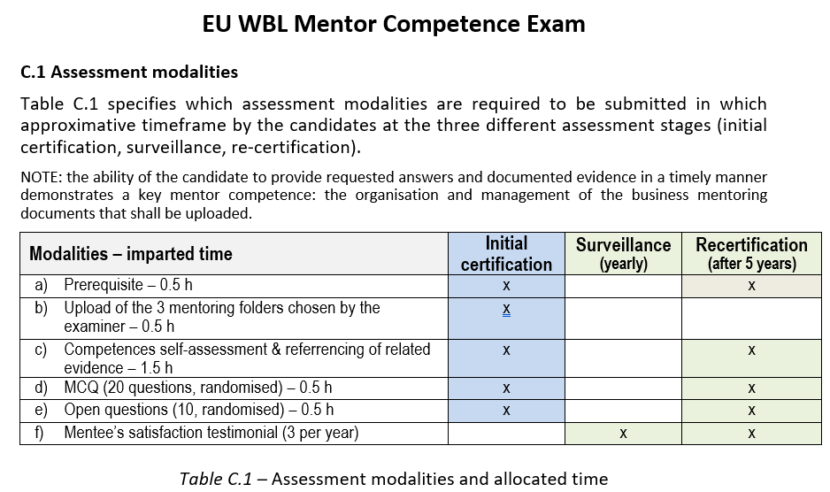
Competence Exam

Slide 16
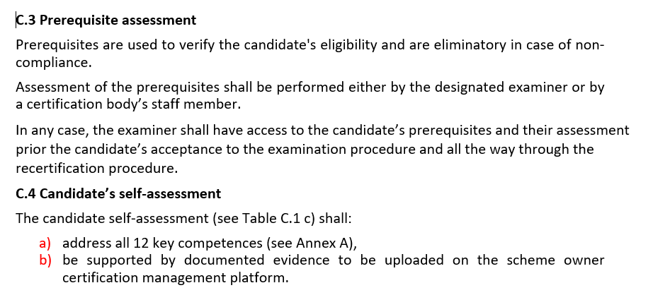
Competence Exam

Slide 17
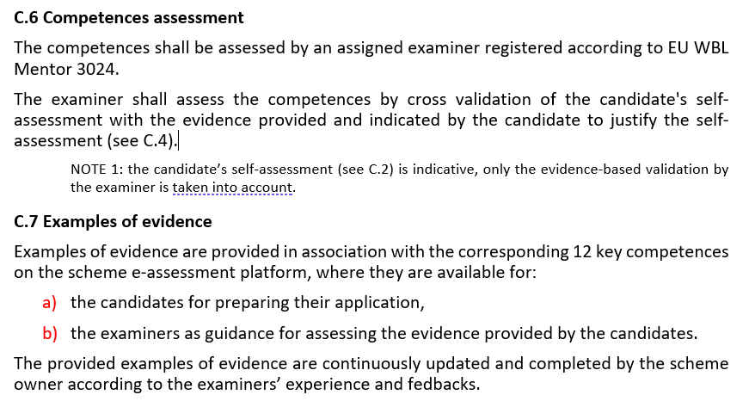
Competence Exam

Slide 18
Examples of evidence
3. Socialize the Mentee – Ability to
act as liaison with stakeholders involved in the mentoring process
promote the relationship between the Mentee and his school
Portfolio including at least :
A company’s presentation
A Mentoring Expectations Agreement
A communication with the stakeholders plan
6. Develop a productive mentoring relationship – Ability to
recognize and build upon abilities of the mentee to nurture a productive relationship
manage this relationship for achieving mutual benefit
encourage positive changes based upon strengths
apply creative communication tools and techniques to establish trust and open communication
support the mentee through identifying needs and advocating when/where appropriate
Reflexive journal or portfolio including at least :
An assessing match checklist by both the mentor and the mentee
An assessing the mentoring relationship checklist by both the mentor and the mentee

Slide 19
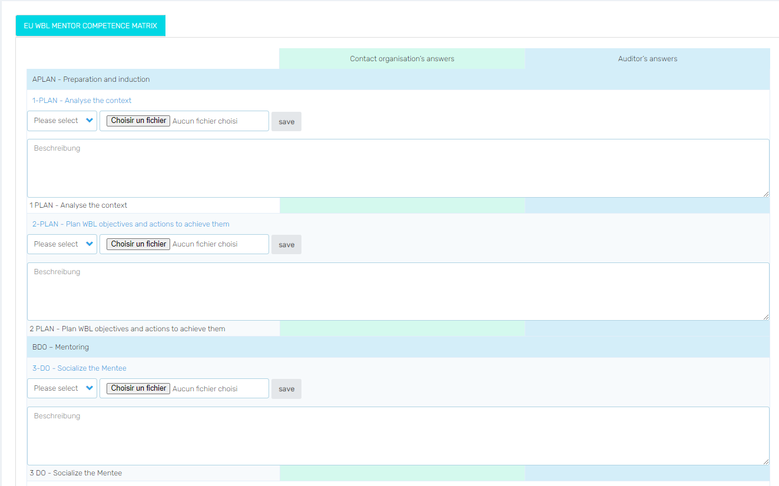
Evidence-based self-assessment

Slide 20
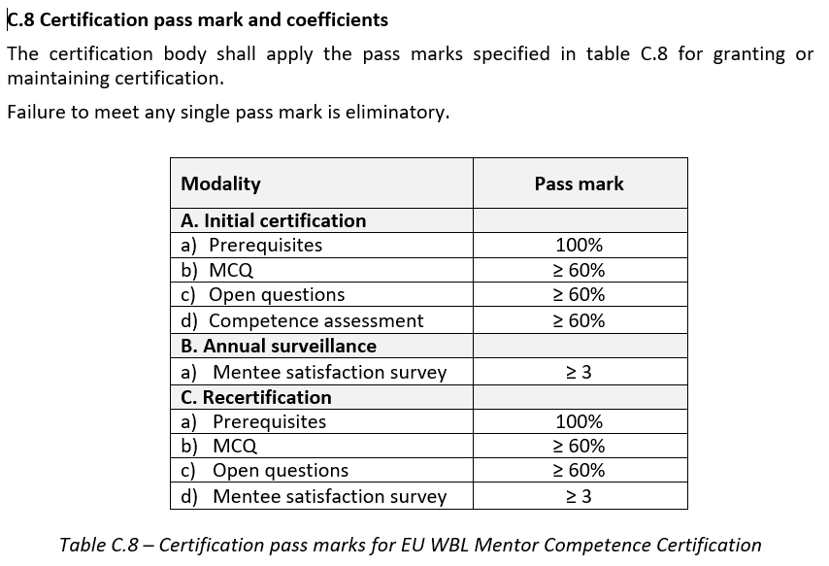
Competence Exam

Slide 21
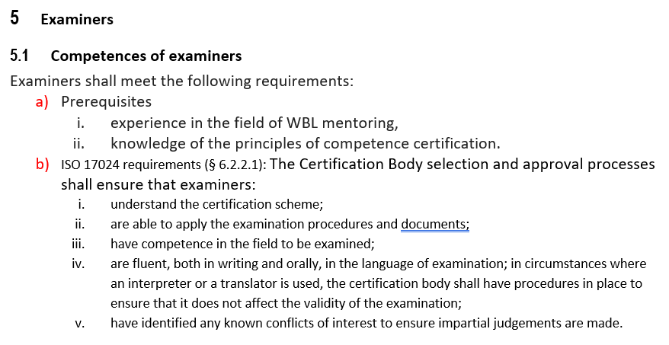
Examiners

Slide 22
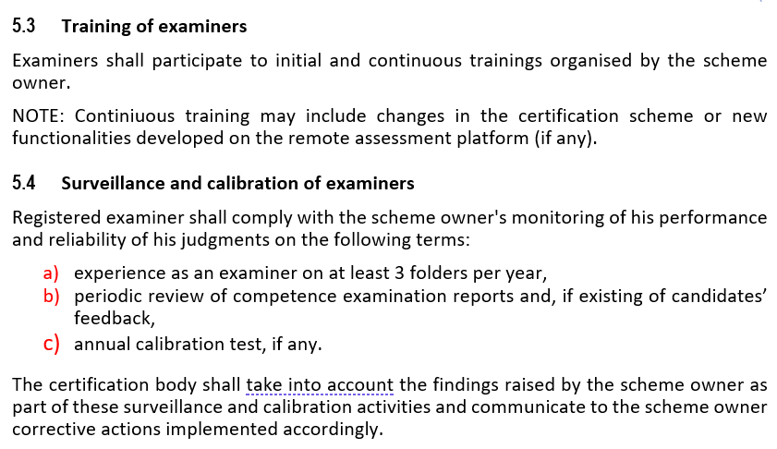
Examiners

Slide 23
Pilot Organisation II
Experimental dispositions
WBL Mentors will be allocated in 2 groups
with preliminary training
without preliminary training
Objectives:
compare the success rate with & without training (O5)
check feasibility of certification without preliminary O5 training
identify potential additional training topics & needs (e.g. exam & folder preparation)

Slide 24
Pilot Organisation III
Testers’ Training
Scope:
platform structure & use
exam preparation
exam folder use & format
Objectives:
get familiar with the platform
know how to prepare the exam
anticipate the necessary folders to prepare and related time management
know how the exam results will be marked and displayed
Modalities:
Examiners and WBL Mentors together
1 single session of 2 hours
Attendance of all partners
Time frame:
November 2020

Slide 25
Pilot Organisation IV
Exam Process
Environment:
Each candidate gets login codes and connects from home
Unlimited connection time for piloting
Prerequisites
candidates enter their prerequisites
examiners assess the prerequisites and release the candidates
Exam management:
open access over week 50
evidence-based self-assessment on the ViaSyst platform
Exam marking:
examiners will be assigned by ViaSyst / EFCoCert
each exam shall be marked by 2 examiners (at least)
blend of examiners with and without WBL mentoring experience
marking results will be compared
Examiner calibration:
2 representative test candidates shall be assessed by all examiners
outcome reproducibility will be compared
Time frame:
December 2020

Slide 26
Pilot Organisation V
Exam Process Validation
Objectives:
Assess reliability and representativity of the exam results
Validate the pass marks by comparing various models
Assess reproducibility of the exam marking process
Compare the success rate with & without training
Compare the assessment outcome for examiners with and without WBL mentoring
Check & validate feasibility of certification without preliminary training
Identify potential additional training topics & needs (e.g. exam & folder preparation)
Identify scheme & platform adaptation needs
Collect / complete examples and good practices of demonstrative evidence
Modalities:
Testers and experts’ committee provide comments through the template
EFCoCert & Viasyst establish & circulates a preliminary synthesis report
WBL providers cross-check the results with the candidates’ reputation
Figures & options are discussed and agreed in a common meeting
Scheme finalisation:
EFCoCert edits the scheme documents
ViaSyst adapts the platform (as feasible within budget limits)
Release:
Partners release the final scheme version
Time frame:
January 2021

